Slide 1


Course: Object Oriented Programming
Thinking in Objects
When Good Code Isn’t Good Enough
Evis Plaku

Slide 2

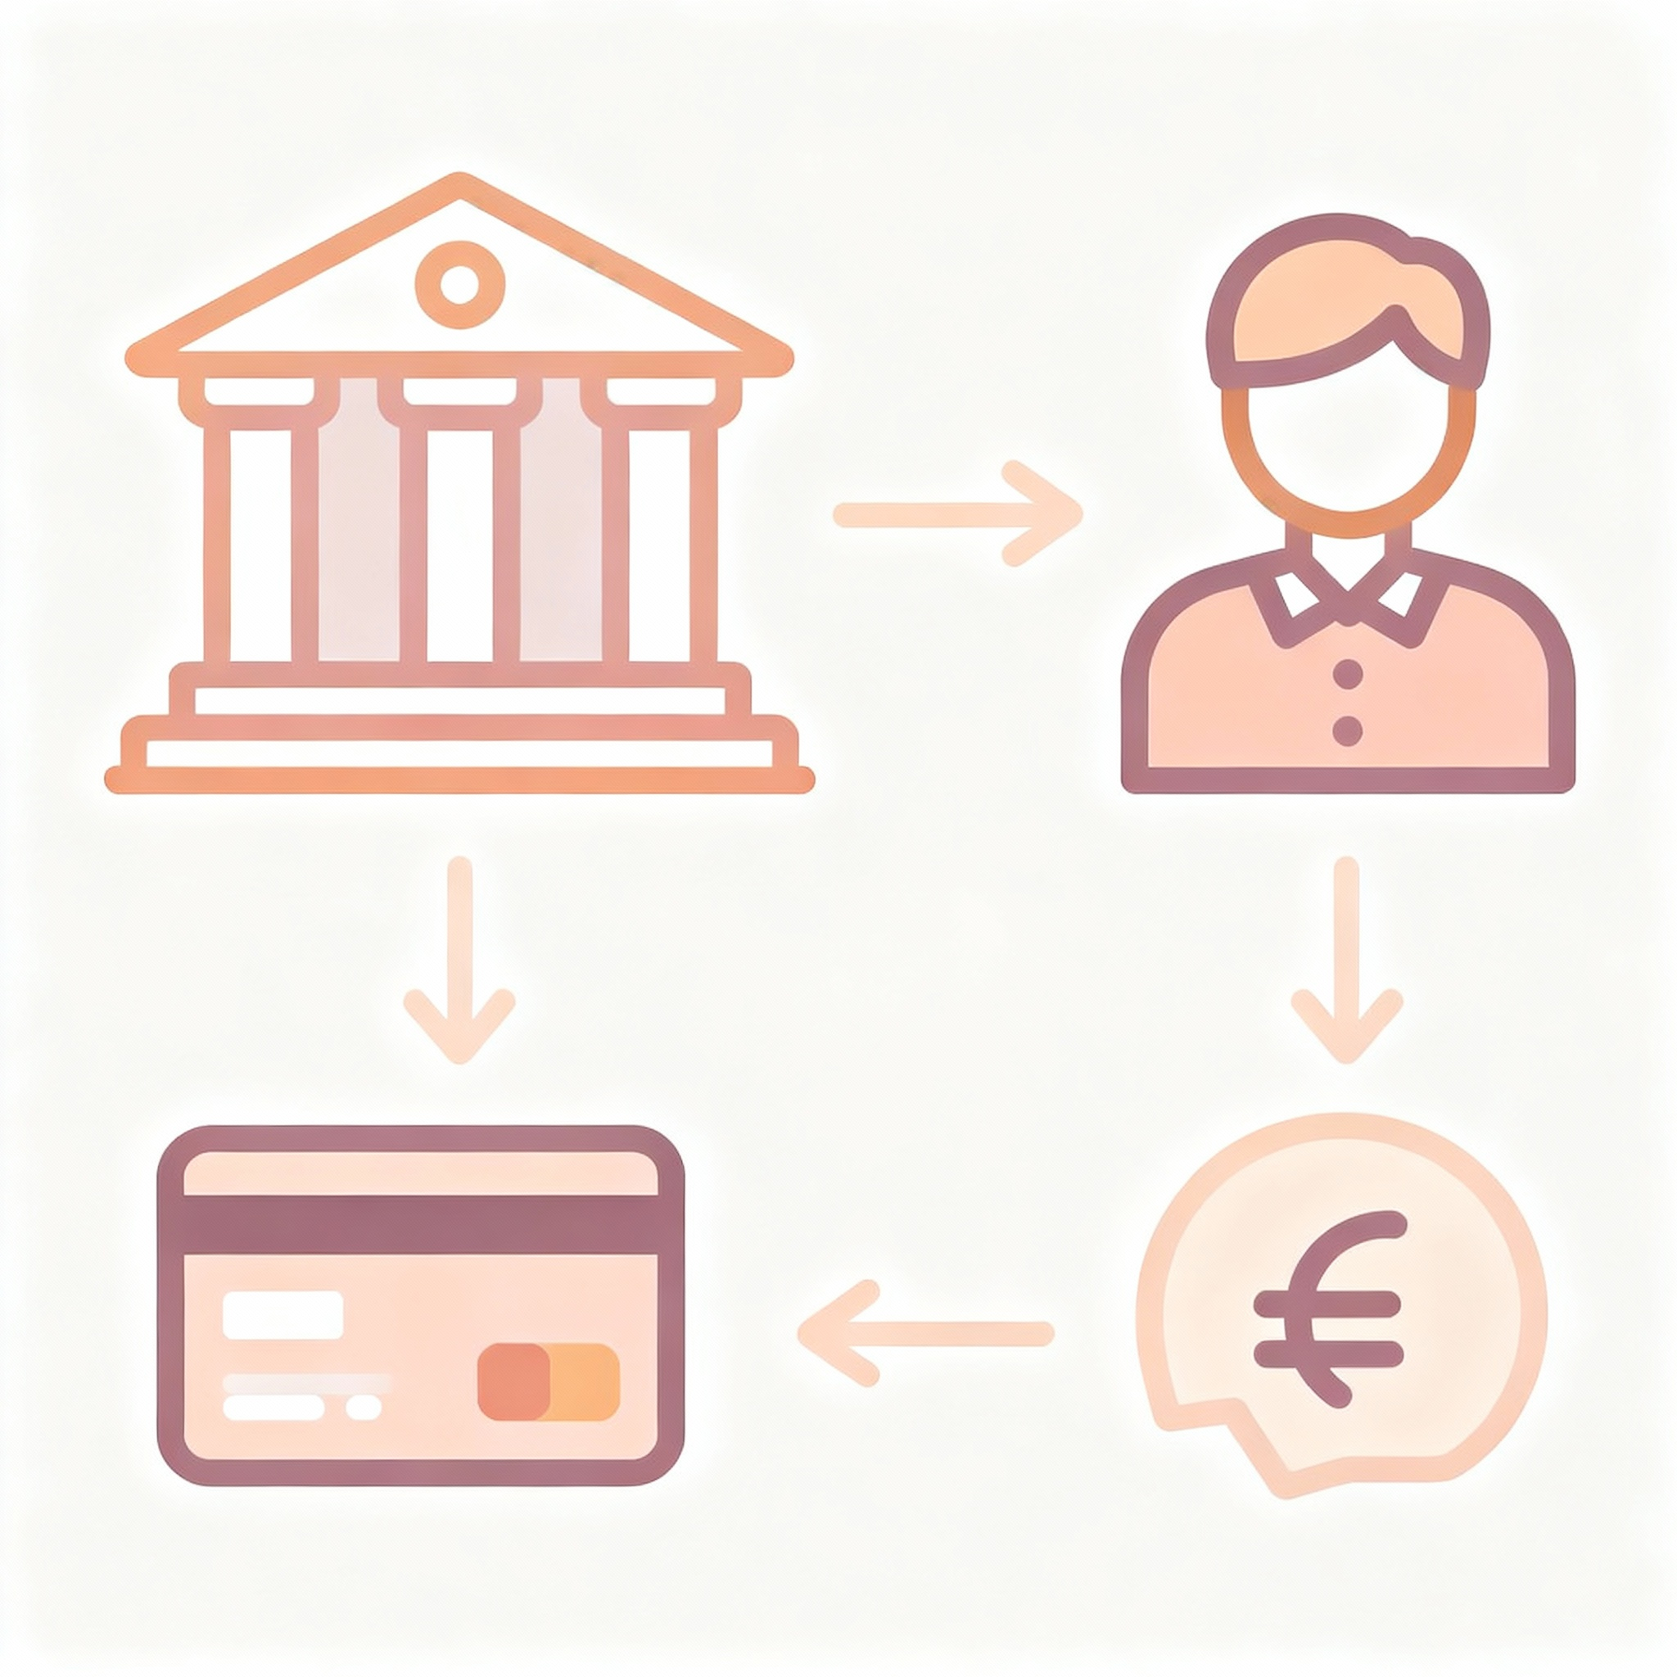
Why Design Matters
Working code isn't enough Design determines if it stays working
Bank
Customer
Bad design costs compound as software grows larger and more complex
Good design makes tomorrow's changes feel easy and natural
Transaction
Account

Slide 3


The Hidden Problem
Our Customer class was doing three different jobs at once
Transaction
Customer managed personal information (name, age, address) - that's fine
Customer managed its list of accounts - still reasonable
Customer handled deposits and withdrawals - wait, that's too much!
Personal Info
Account

Slide 4


Code Smell: Too Many Responsibilities
When one class does everything, changing anything breaks everything
Want to change how deposits work? Risk breaking customer management
Want to add reports? Customer class gets even more bloated
Testing becomes nightmare because everything is tangled together

Slide 5


Single Responsibility Principle
Each class should have exactly one reason to change
Customer changes when we change customer information rules
Bank changes when we change how operations are coordinated
Account changes when we change how transactions work
Bank
Customer
Account

Slide 6


The Refactoring Solution
Split responsibilities into focused classes instead of one
Coordinate Customers
Customer owns accounts and manages personal data - nothing else
Bank coordinates operations between customers - its only job
Account tracks its own transactions – self-contained
Customer
Info & Account
Track Transactions

Slide 7

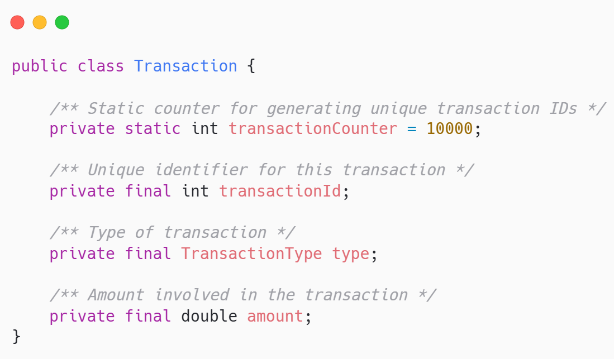
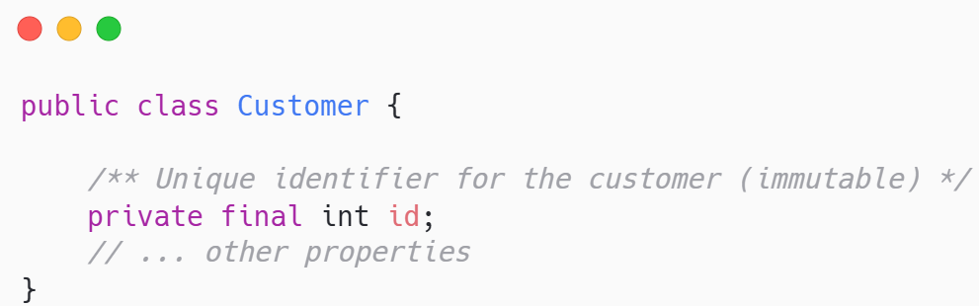
Immutability - Objects That Never Change
Some data should never change after creation
IDs should never change once assigned to objects
Transaction records must never be altered for audit integrity
Use final and static keywords: compiler enforces the rule for you
Impossible to change

Slide 8


Why Immutability Matters
Bugs love mutable state Eliminate the state, eliminate the bugs
No accidental changes means fewer surprises in your code
Thread-safe automatically - critical for banking systems, and others
Easier to reason about: object created, object stays same

Slide 9

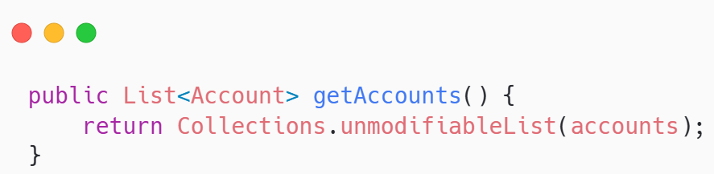
Defensive Copying
Never hand out your internal list Give them a read-only view
Return Collections.unmodifiableList() instead of raw ArrayList
Prevents external code from modifying your internal state
Example: getAccounts() returns safe view, not actual list

Slide 10

Technical Implementation

Slide 11
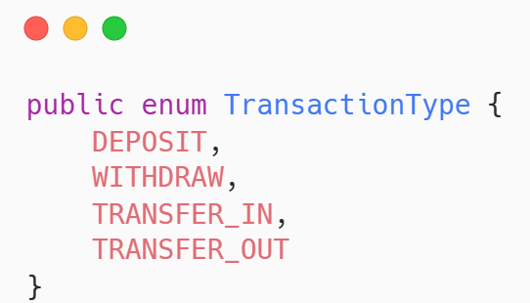
The String Problem
Using strings for types lets typos become runtime bugs
“DEPOSIT” vs “deposit” vs “Deposit” all different strings!
Compiler cannot help you catch spelling mistakes
We need something better: use enums

Slide 12

Enums - Type Safety
Enums let compiler enforce only valid values can exist
Define types once: DEPOSIT, WITHDRAW, TRANSFER_IN, TRANSFER_OUT
Impossible to misspell - IDE autocompletes the valid options
Switch statements warn you if you forget a case
Enums make code clearer and catch errors before runtime

Slide 13


Object equality problem
Default equality compares memory addresses, not actual content
Two Customer objects with same ID are different without override
Collections need proper equals for correct behavior
We must teach Java what makes two objects "the same"

Slide 14
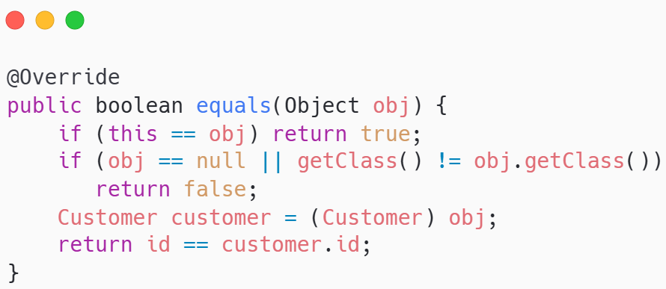
The equals() Method
Override equals to compare meaningful fields, not memory location
Check same reference first: fastest path for identical objects
Check null and class type prevents crashes and wrong comparisons
Compare ID field: two customers same if IDs match

Slide 15

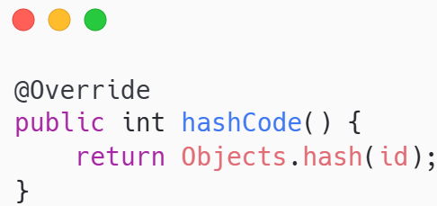
The hashCode() Contract
Equal objects must have equal hash code Always override together
Use same fields as equals method for consistency
Collections like HashSet depend on this working correctly

Slide 16

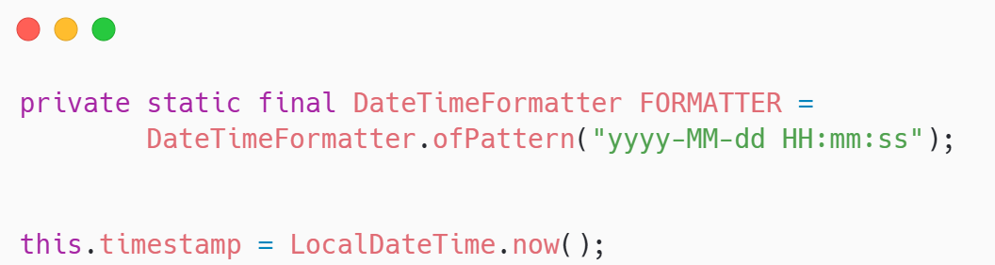
Modern Date Handling
LocalDateTime replaces deprecated Date class with better design
Immutable and thread-safe by default
Clear API: LocalDateTime.now() is obvious
Transaction timestamps use this for reliable audit trails

Slide 17
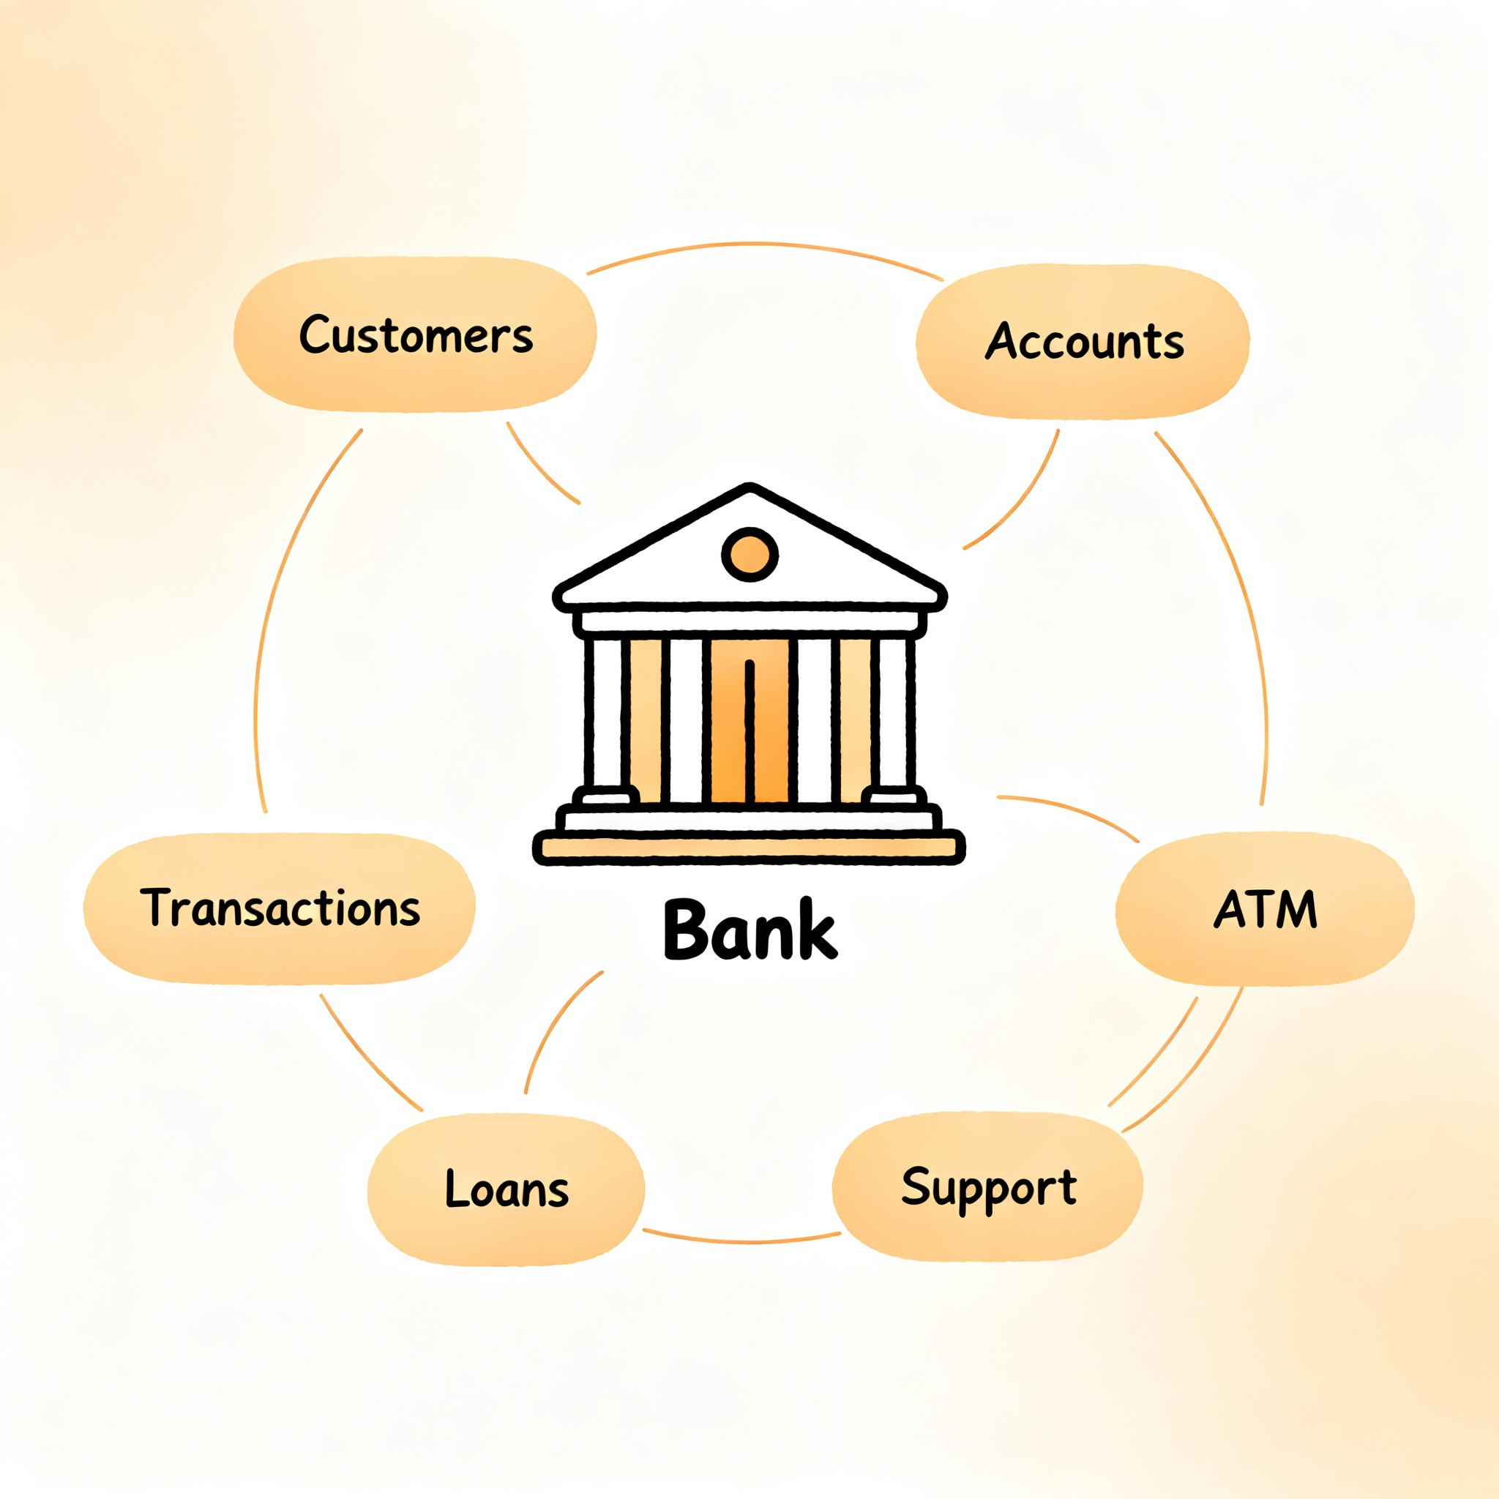
Bank System Example

Slide 18

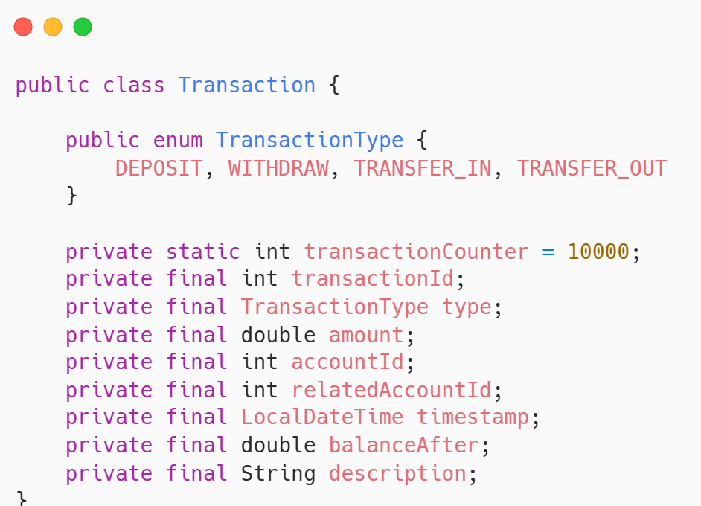
The Transaction Class
Every bank operation creates a permanent, unchangeable transaction record
Captures who, what, when, how much for complete history
Immutable value object - cannot be modified after creation
Automatic ID generation ensures every transaction is unique

Slide 19
Transaction structure
Each transaction knows everything about itself for perfect auditing
ID and type (enum) identify the transaction uniquely
Amount, timestamp, balance after capture complete state
Description provides human-readable context for later review

Slide 20

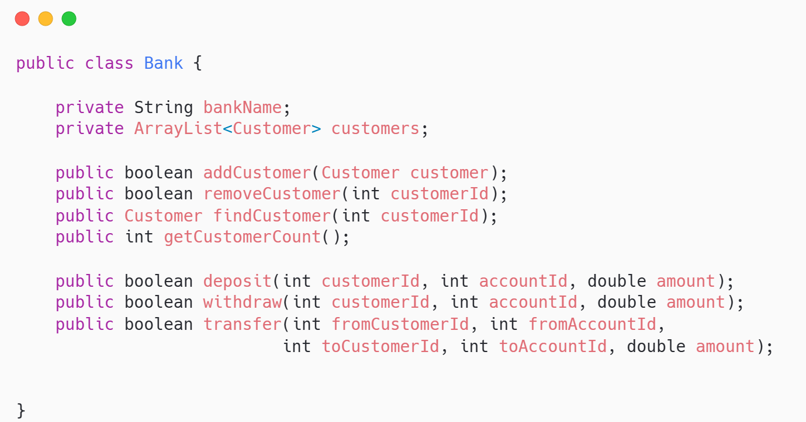
The bank class
Bank coordinates all operations between customers - nothing else
Manages collection of customers
Handles transfers that involve two different customers

Slide 21

Why we need the bank class
Customer cannot and should not know about other customers
Transfer needs both accounts: only Bank sees both customers
Violates SRP if Customer manages other customers' accounts
Real banks coordinate customers our code should match reality

Slide 22

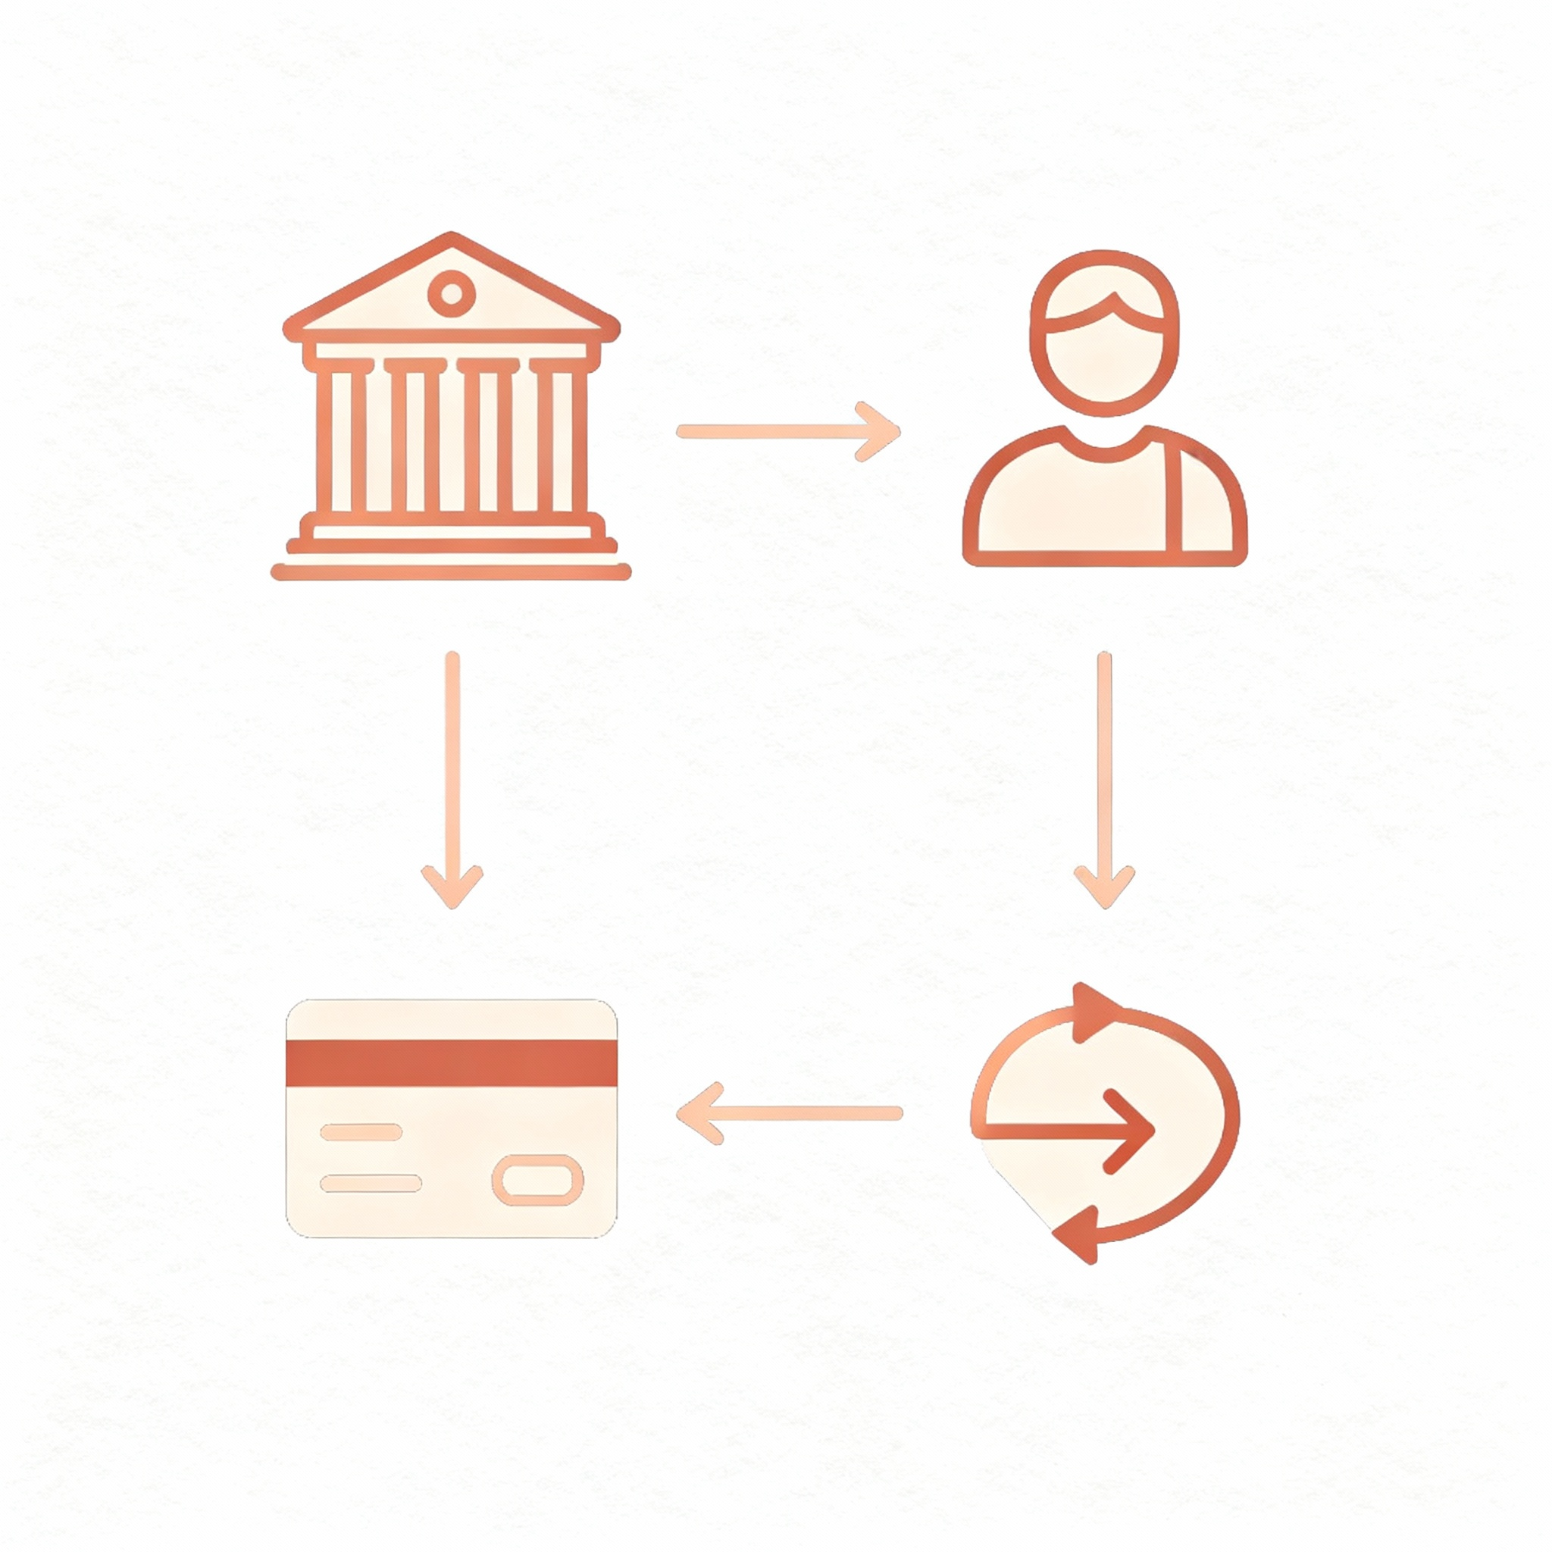
The power of good design
Similar functionality, clearer structure, easier to extend and test
Customer version 2: had deposit and withdraw methods
Customer version 3: only manages its own account list
Bank version 3: handles all financial operations through accounts
Bank
Customer
Account
Transaction

Slide 23
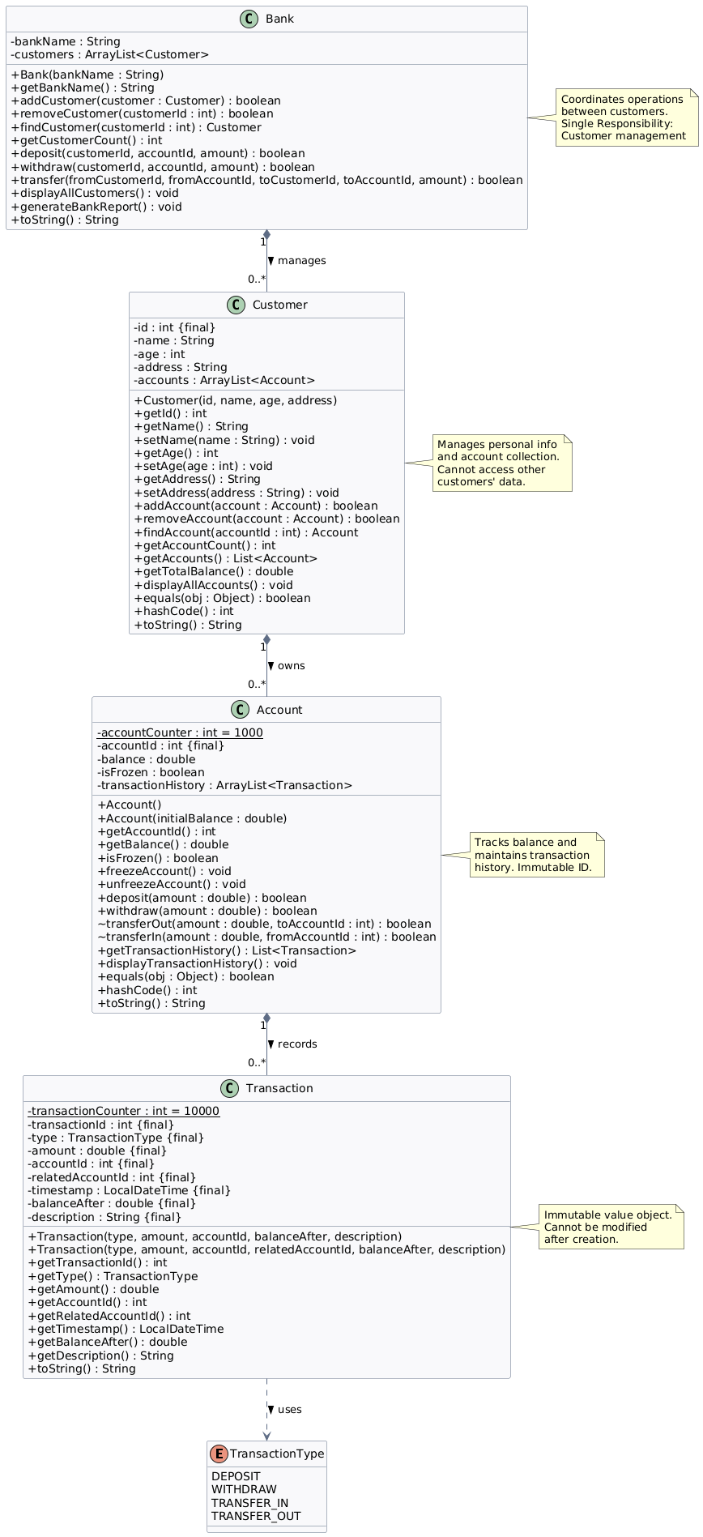
Class diagram version 3
Class diagram shows key entities and their relations
Composition relationships (strong)
Dependency Relationship
Bank ◆──► Customer (1 to many)
Customer ◆──► Account (1 to many)
Account ◆──► Transaction (1 to many)
Transaction ──► TransactionType (uses)
Zoom in to view class diagram

Slide 24


Quote of the week
Do One Thing And Do It Well

